Slide 1



Facial Recognition-
Based Attendance System for Classrooms
Presented by :- Batch-1 , Group-6 (AI-A)
next slide

Slide 2
TY_AIDS_A_GROUP_6
11
Sr. No. | NAME | ROLL NO | PRN
1 | Amit Naphade | 5 | 12210473
2 | Sahil Bhoje | 25 | 12210733
3 | Parth Bhurke | 29 | 12211537
Guided By: Prof. Shweta Kambare
Recognied faces list

Slide 3


02
Introduction
This project aims to automate attendance marking by using face recognition technology. It processes group photos to detect and recognize faces, leveraging advanced models like MTCNN for face detection and FaceNet for feature extraction. The system ensures accuracy through preprocessing techniques and handles diverse inputs, making attendance marking efficient and reliable.

Slide 4
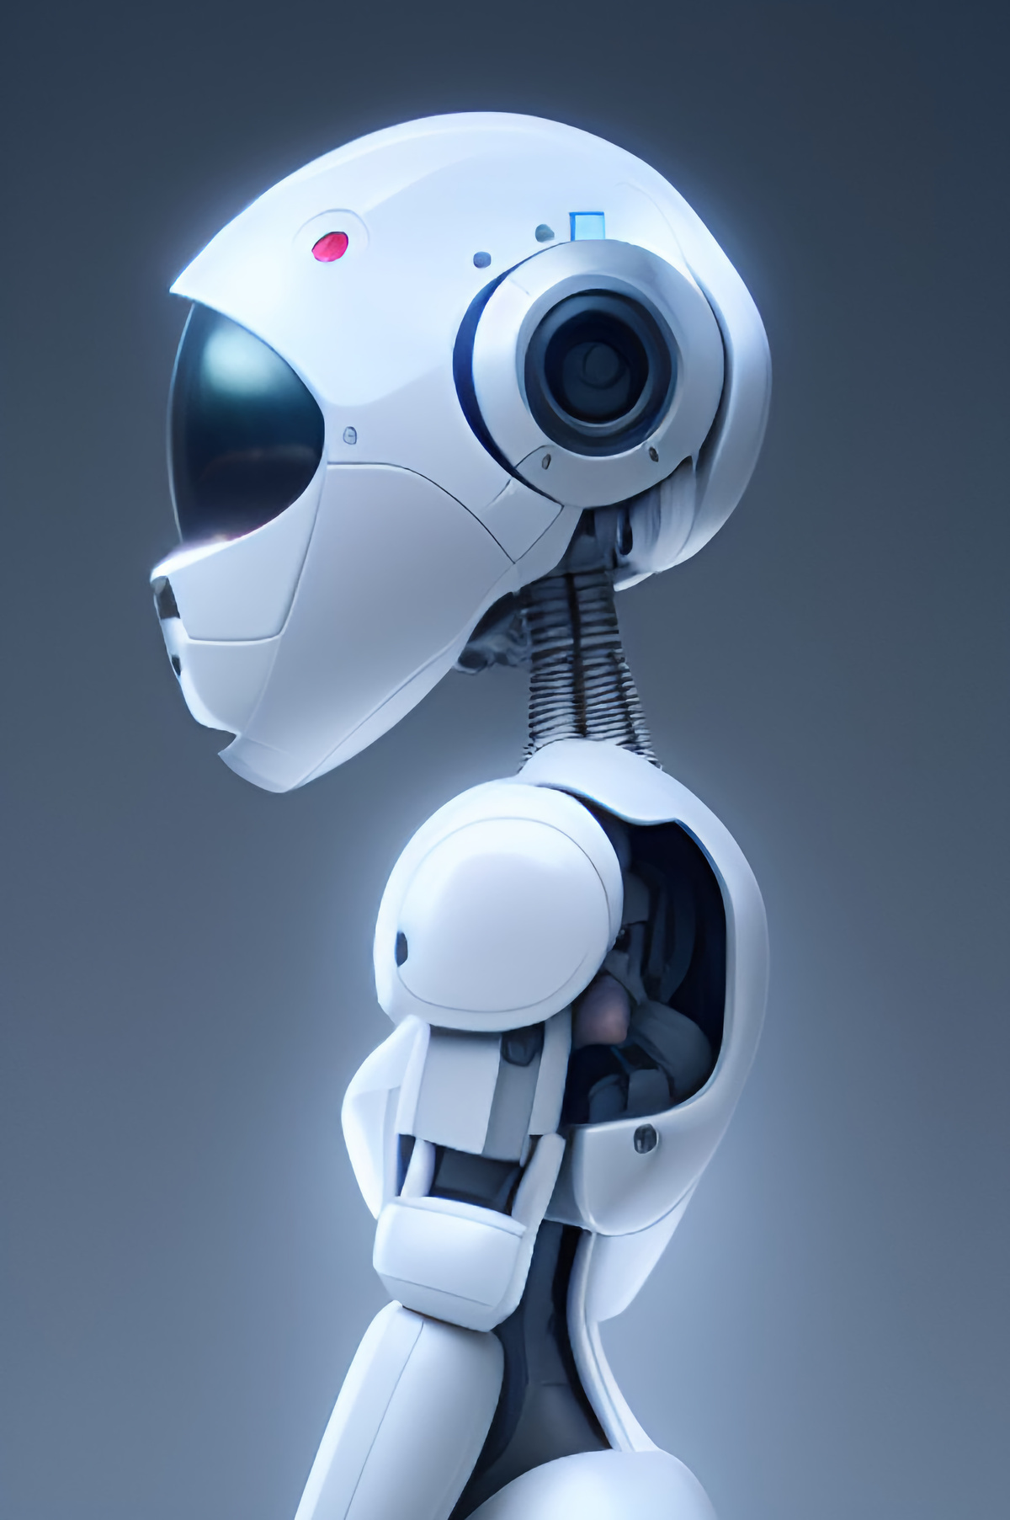
Problem statement
06
Manual attendance marking in classrooms and workplaces is time-consuming, prone to errors, and inefficient, especially for large groups. Existing systems often lack scalability, accuracy, or automation. This project addresses these challenges by developing an automated attendance system using facial recognition. The system detects faces in group photos, matches them against a pre-trained database, and marks attendance accurately and efficiently, minimizing human intervention and improving reliability.

Slide 5
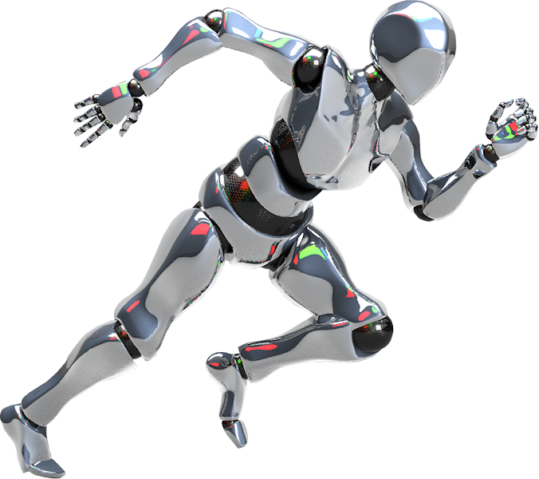
Literature Survey
07
Title | Author(s) | Abstract | Methodology | Gaps Found
FaceTime – Deep Learning Based Face Recognition Attendance System | Marko Arsenovic, Srdjan Sladojevic, Andras Anderla, Darko Stefanovic | This paper proposes a deep learning-based attendance system using CNN cascades for face detection and FaceNet embeddings. It addresses challenges with small datasets through novel augmentation techniques and achieves 95.02% accuracy in real-time environments, offering a scalable solution for monitoring systems. | A CNN-based model integrates a cascade for face detection, positioning based on landmarks, and feature embedding via FaceNet. Image augmentation (blurring, noising, adding accessories) is used to enhance a small dataset. Classification is performed with an SVM on generated embeddings. Tested in a real-time environment with an overall accuracy of 95.02%. | Challenges with smaller datasets. Environmental lighting conditions affected accuracy. Suggestion for further exploration of new augmentation techniques and real-time retraining mechanisms.
Real-Time Smart Attendance System using Face Recognition Techniques | Shreyak Sawhney, Karan Kacker, Samyak Jain, Shailendra Narayan Singh, Rakesh Garg | This paper introduces an automated attendance system combining Eigenfaces, PCA, and CNNs for facial recognition. The system tackles authentication challenges and proxy prevention, using cameras inside and outside classrooms to link recognized faces to a database, ensuring efficient attendance tracking. | Combines Eigenfaces, PCA, and CNNs for face detection and recognition. Two-camera system ensures no proxies: one camera outside the classroom for access control, another inside for presence confirmation. Enrolment involves storing student details and images in a database for future matching. | Lack of multi-face real-time processing capability. Challenges in scaling for larger environments (e.g., corporate settings). Needs integration with robust security mechanisms for broader applications like banking or corporate surveillance.
Study of Implementing Automated Attendance System Using Face Recognition Technique | Nirmalya Kar, Mrinal Kanti Debbarma, Ashim Saha, Dwijen Rudra Pal | This study presents a face recognition-based attendance system using PCA and Eigenfaces. It automates attendance marking, leveraging OpenCV for detection and a log system for easy faculty access to records, ensuring efficient and non-invasive authentication. | Uses PCA and Eigenfaces for training and recognition. OpenCV is employed for HaarCascade-based face detection. System captures frontal faces, performs preprocessing, and stores eigenvalues for future comparisons. A log records clock-in and clock-out times for attendance tracking. | Limited angle recognition—only frontal faces achieved high accuracy. Insufficient dataset size and diversity. Poor performance on non-frontal or profile views, as shown by a drop in recognition rates with increased face angles.

Slide 6
Literature Survey
07
Title | Author(s) | Abstract | Methodology | Gaps Found
Attendance System Using Face Recognition and Class Monitoring System | Prof. Arun Katara, Mr. Sudesh V. Kolhe, Mr. Amar P. Zilpe, Mr. Nikhil D. Bhele, Mr. Chetan J. Bele | This paper presents a face recognition-based attendance system using Raspberry Pi. The system automates attendance marking by detecting and recognizing faces through continuous observation, enhancing accuracy. It uses the OpenCV library for image processing and maintains a MySQL database for attendance storage. The method saves time compared to traditional approaches and reduces errors related to fake attendance. | Utilized OpenCV for face detection and recognition. Continuous observation for attendance estimation. Preprocessing techniques like histogram normalization to improve image quality. Employed PCA for feature extraction and dimensionality reduction. Attendance recorded in a database and integrated with a GUI developed using WampServer. | Difficulty in different lighting conditions. Limited recognition rate improvements. Future scope includes infrared cameras and surveillance extensions
Class Room Attendance System Using Facial Recognition System | Abhishek Jha | This paper discusses the use of 3D facial modeling to improve the precision of automated attendance systems. The goal is to provide an accurate and efficient mechanism for attendance recording in educational institutions. Unlike traditional methods, the proposed system employs advanced facial recognition technologies to ensure reliable identification. | System based on feature detection (e.g., eyes, nose, mouth) and alignment. Employed techniques like PCA and Linear Discriminant Analysis (LDA) for feature extraction. System developed and tested in MATLAB. | Scalability for large student databases was not addressed. Dependence on a specific hardware/software ecosystem like MATLAB
Implementation of Classroom Attendance System Based on Face Recognition in Class | Ajinkya Patil, Mrudang Shukla | This paper introduces an attendance system employing face recognition techniques integrated with Raspberry Pi. It uses image processing algorithms for detecting and recognizing faces within a classroom. The system automates attendance marking, reducing manual intervention and improving accuracy. efficient and non-invasive authentication. | Viola-Jones algorithm for face detection. Hybrid PCA-LDA model for face recognition. Preprocessing steps like histogram normalization and noise filtering to enhance image quality. Attendance records maintained on a central server. | False detection in varying lighting conditions. Lack of scalability and real-time robustness. Proposed future enhancements include GSM modules for security extensions

Slide 7
Literature Survey
07
Title | Author(s) | Abstract | Methodology | Gaps Found
Face Recognition Systems: A Survey | Yassin Kortli, Maher Jridi, Ayman Al Falou, Mohamed Atri | This paper reviews various face recognition techniques, categorized as local, holistic, and hybrid approaches. It provides a taxonomy, comparisons in robustness, accuracy, and complexity, and an overview of databases used for supervised and unsupervised learning. Numerical results and experimental contexts for the methods are discussed, concluding with future directions in improving these systems. | Survey and categorization of face recognition techniques into local, holistic, and hybrid approaches. Analysis of strengths and weaknesses in various techniques. Overview of popular databases for face recognition evaluation. Examination of experimental results for notable methods. | The need for real-time processing and higher memory efficiency. Challenges in uncontrolled environments, such as variations in lighting, head orientation, and expressions. High complexity and resource requirements of advanced techniques.
An Introduction to Face Recognition Technology | Shang-Hung Lin | The paper provides an overview of face recognition technology, emphasizing its applications in network security, multimedia processing, and teleconferencing. It introduces key algorithms like eigenfaces and neural networks, discusses challenges such as illumination and pose variations, and outlines a general framework for face recognition systems. | Explanation of generic frameworks for face detection and recognition systems. Introduction of major algorithms, such as the eigenface and neural network approaches. Discussion of performance metrics like False Rejection Rate (FRR) and False Acceptance Rate (FAR). | Need for more robust handling of variations in lighting, expression, and pose. Limitations in real-world scenarios where facial features may be occluded or distorted.
Face Recognition-based Lecture Attendance System | Yohei Kawaguchi, Tetsuo Shoji, Weijane Lin, Koh Kakusho, Michihiko Minoh | The paper proposes a system for automating student attendance in lectures using continuous face recognition. It employs dual cameras for seat identification and face detection, using continuous observation to improve accuracy. | Dual-camera system with one camera identifying occupied seats and another capturing face images. Continuous observation to enhance detection and recognition accuracy. Voting-based seat assignment and real-time processing using the Linear Sum Assignment Problem (LSAP). | Limitations in accuracy due to environmental noise and occlusions. Challenges in scaling the system for larger classrooms. Dependence on prior manual registration of student faces.

Slide 8



Methodology
04
Data Collection
Preprocessing the data
Face Detection
Preprocessing involving Face detection MTCNN.
Collected individual facial data for each user.
Identifies and localizes faces within input images using the MTCNN detector.
Attendance Marking
Face Recognition
Saving Embedings
Automatically records attendance by identifying and verifying individuals' faces present in the input image.
Identifies individuals by comparing their face embeddings with the stored database using similarity metrics.
Encodes facial features into a unique numerical vector using the FaceNet model for recognition.

Slide 9
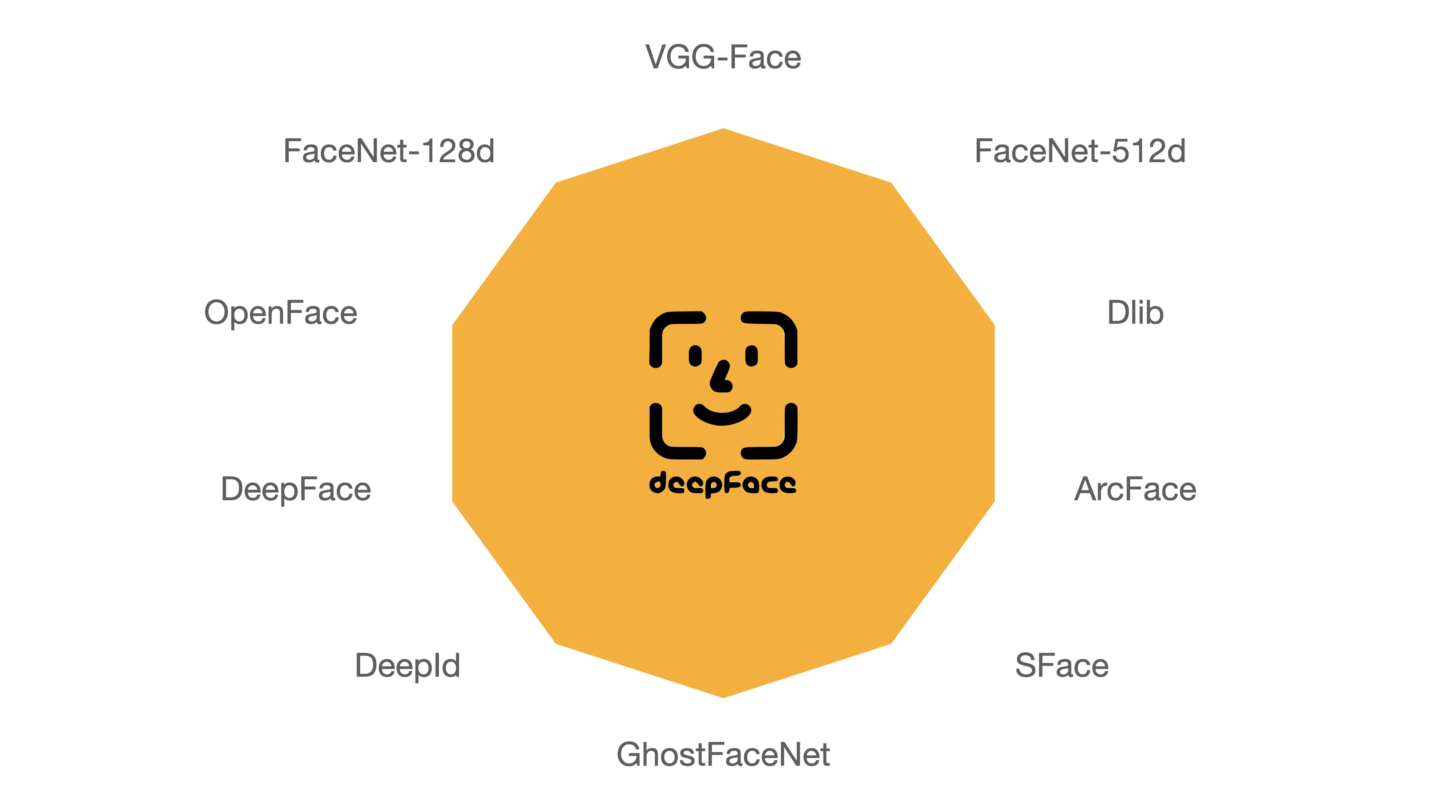



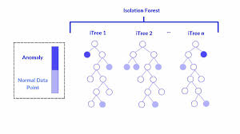

Tools and Technologies
03
Face Net
Python
Tensor FLow
Open CV
MTCNN
Isolation Forest

Slide 10
Results
12
Inputs | Face Available | Face Detected | Accuracy | Precision | Recall
Input 1 | 14 | 14 | 100 % | 100 % | 100 %
Input 2 | 14 | 14 | 100 % | 100 % | 100 %
Input 3 | 7 | 7 | 100 % | 100 % | 100 %
Input 4 | 3 | 3 | 100 % | 100 % | 100 %
Input 5 | 14 | 12 | 85 % | 100 % | 85.71 %
TOTAL | 52 | 50 | 97 % | 100 % | 97.14 %

Slide 11
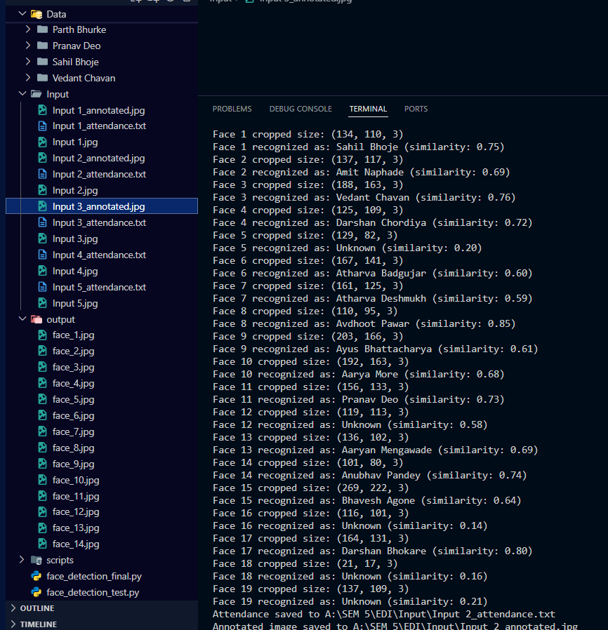
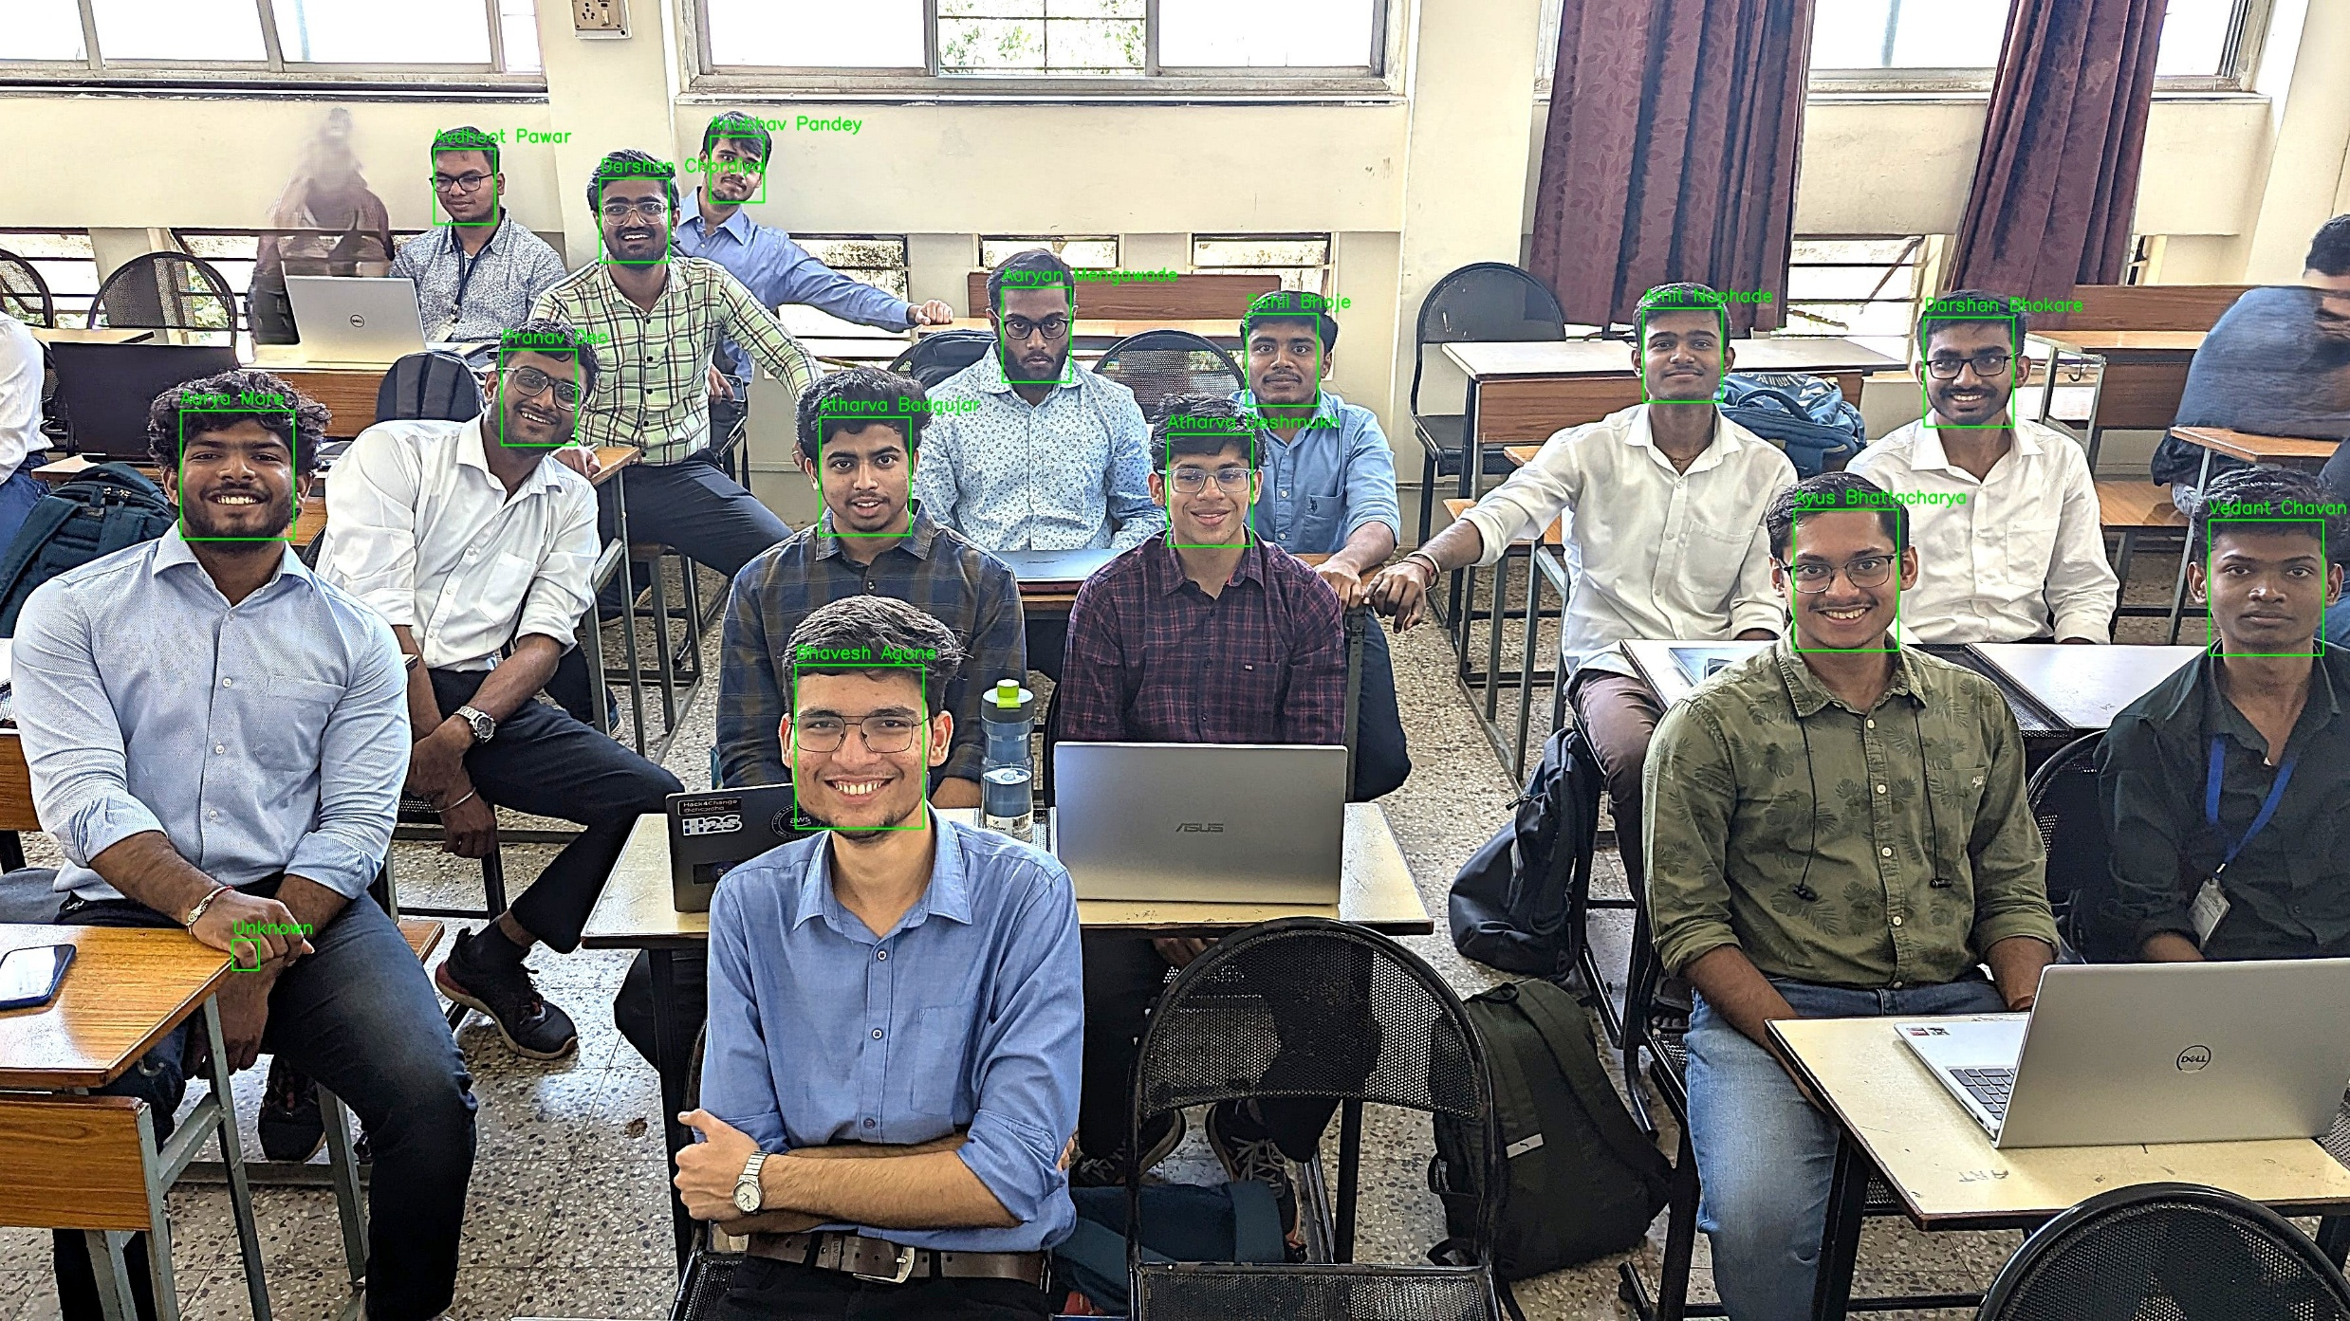
Output snapshot:
11
Recognized faces list
Recognized faces in the Input

Slide 12
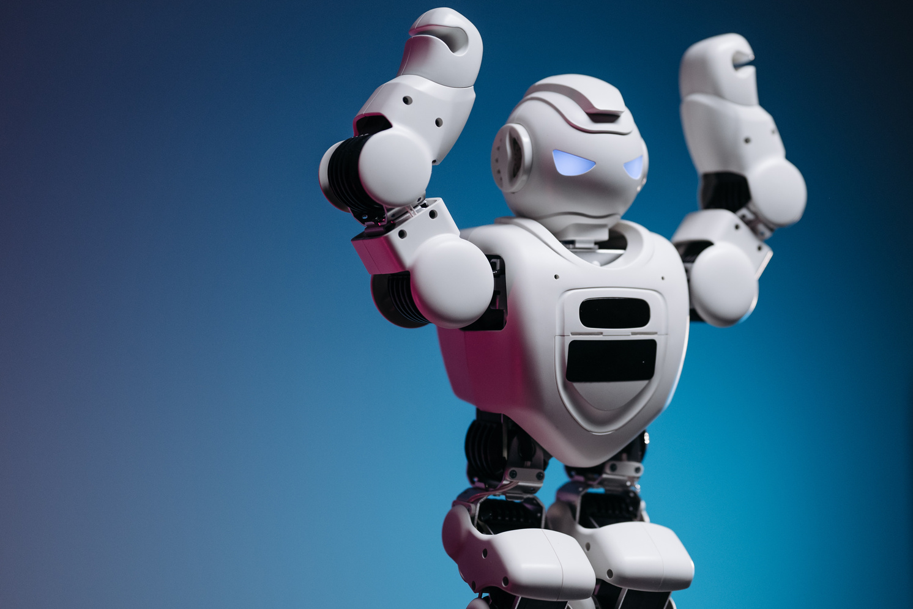
Challenges and Opportunities
14
Challenges faced
Lighting Conditions: Variations in illumination affected face detection and recognition accuracy.
Pose Variations: Non-frontal or tilted faces reduced recognition performance.
Overlapping Faces: Close proximity of individuals in group photos caused detection issues.
Real-Time Constraints: Processing large group images quickly posed computational challenges.
Future Scope
Cloud-Based System: Develop a cloud-based platform for remote access and centralized attendance management.

Slide 13
02
conclusion
This project successfully developed a robust and scalable face recognition system for attendance marking. By combining effective face detection, embedding generation, and recognition techniques, the model accurately identifies individuals in diverse scenarios.
Its ability to handle both small and large groups showcases its scalability, making it suitable for real-world applications in classrooms and workplaces. The system's reliable performance, coupled with future integration possibilities, highlights its potential for broader adoption and enhancement in automated environments.

Slide 14
Thank You!

